Slide 1
Quill Release Notes
Nov 2025

Slide 2
Key Features – Quill Authoring
Contact/Agent ‘Title’ and ‘Logo Image’
Enable ‘Mass Unit’ and ‘Dosage Unit’ for Concentrations
  Previously we only enabled ‘Concentration Unit’ – we would like to discuss
Shade ‘Manufacturer’ statement types with an amber background
  Similar to shading of statements that are of type ‘CLP’ (blue) or ‘Regulatory’ (green)
Translate: auto-set source language
Duplicate section: default the text ‘DUPLICATE:’
Expand/Collapse common metadata in the Metadata pane
Link Authoring to Reference Data: Package Type, Packaging Materials, Phone Number Type

Slide 3
Key Features – Quill Authoring – GAP/DFU
Change ‘GAP’ to ‘GAP/DFU’ (ribbon, breadcrumb)
NEW: Seed Treatment Use Rate Group
Application Timing Group (Treatment Window) > Description reference data (per growth stage)
  Crop Growth Description text field
  Weed Growth Description text field
Ribbon improvements: Leaf icon updates, Water/Carrier menu
GAP > Maximums > AgriGuide Units of Measurement
GAP > Maximums > Max Total Rate per Area per Time (numberOfApplications.perDuration for both applicationTotalDosageExpression and activeIngredientTotalDosageExpression in numberOfApplications)

Slide 4
GAP/DFU New Features
NEW: Vehicle Speed Min and Max (already in Spraying Instructions (Advanced))
NEW: Boundary Closed Nozzle Count
UPDATE: Cultivation Setting, Treatment Reason (allow many)
NEW: Application Target (Advanced)
  NEW: Paragraphs
  Application Target Time
    NEW: Length
    NEW: Event Description
  Application Target Site
NEW: Safety Interval
  Application Target Time
    NEW: Length
    NEW: Event Description
Application Options
  NEW: Title
  Application Sequence
    NEW: Title
    NEW: Number of Applications
Application Sequence
  NEW: Title
  NEW: Total Number of Applications

Slide 5
Crop and Pest Stages
Crop Stage Group
  Height Metadata
  Height (Min, Max)
  Lifecycle Stages
Pest Stage Group
  Height Metadata
  Height (Min, Max)
  Lifecycle Stages

Slide 6
Spraying Instructions
V1.1 Updated elements:
  Nozzle Name, Nozzle Class
  Min/Max Wind Speed (currently only at GAP/DFU level)
  Min Interval Before Next Forecast Rain (currently only at GAP/DFU level)
  Min Interval Before Next Forecast Rain Text (currently only at GAP/DFU level)
  Min Post-Rain Interval (currently only at GAP/DFU level)
  Min Post-Rain Interval Text (currently only at GAP/DFU level)
  Boundary Closed Nozzle Count
  Buffer Zone Context (currently only at GAP/DFU level)
  Metadata:
    Wind Speed Unit of Measurement
    Application Timing Unit of Measurement (Rain)
V1.2 new elements:
  Growth Stage Description
  Conditional Qualifier
  Crop Growth Stage

Slide 7
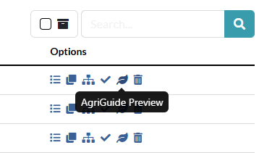
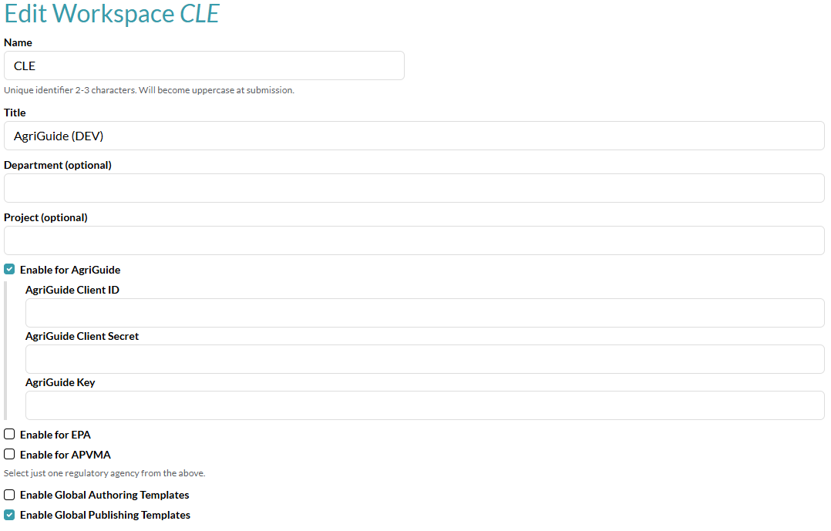
Key Features – Quill CCMS
CCMS = Component Content Management System
Preview from list view
Workspace Admin: add AgriGuide credentials

Slide 8
Key Features – Quill CCMS - DEMO
Please contact us for a demo of an AgriGuide preview to your AgriGuide workspace, which requires your credentials

