Slide 1
Quill Release Notes
Q3 2026

Slide 2
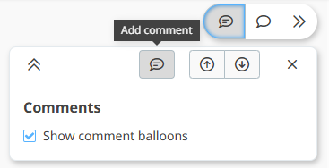
Reviewing in Quill
We have enabled ‘basic’ commenting as well as supporting more advanced comments for filtering/sharing
  No need to Share!
  Doesn’t lose position in the section

Slide 3
Key Features – Quill Authoring - Sections
Product Information:
  Drag/drop subsections
  Reuse a Marketer
  Reuse Additional Advisory
  Reuse Other Mandatory Information
Formulation:
  Reuse a Manufacturer
Precautionary/Hazard Statements
  Info Source: CLP, Manufacturer, Regulatory only
‘Attention’ icon for values that don’t match Reference Data
Language filtering: use ‘en’ plus the selected language
Allow negative values for Storage and Transportation Temp

Slide 4
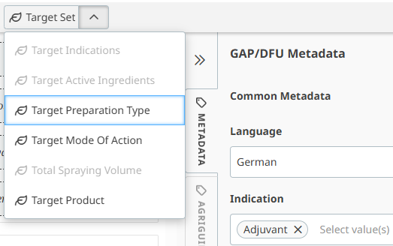
Key Features – Quill Authoring – GAP/DFU
AgriGuide v1.2 – Adjuvants
  For any GAP/DFU where the Indication is set to Adjuvant, you can now author Target Set information
  Target Indication(s)
  Target Active Ingredient(s)
  Target Preparation Type
  Target Mode of Action
  Target Spraying Volume
  Target Product

Slide 5
Key Features – Quill Authoring – GAP/DFU
Quantity object (min/max/value/text/greaterThan/lessThan and unit of measurement) now available consistently here:
AgriGuide Object | Quill Name | AgriGuide Object | Quill Name
adjuvantAmountPerTreatment* animalReEntryInterval applicationDosageExpression* authorisedAbsoluteDoseRate* humanReEntryInterval repeatInterval seedingRate | Additive Use Rate Group Restricted Entry Interval (Animal) Use Rate Group Max Total Rate per Area per Time Restricted Entry Interval (Human) Interval Between Applications Seeding Rate Group (plus Denominator – see next slide) | bufferZones groundInclinationRange nozzleApplicationDosageReduction nozzleDriftReduction nozzleDropletSize vegetationBarrierDepth vehicleSpeed windSpeed | Buffer Zone Context / Distance Ground Inclination Range Nozzle Application Dosage Reduction Nozzle Drift Reduction Nozzle Droplet Size Vegetation Barrier Depth Vehicle Speed Wind Speed
cropSowingPlantingInterval forecastRainApplicationInterval plantingDensity preHarvestInterval successionalCropSowingPlantingInterval sowingDepth temperature vehicleSpeed waterVolumePerTreatment* windSpeed | Pre-Sowing or Planting Interval Interval Before Next Forecast Rain Foliage Density Pre-Harvest Interval Pre-Sowing or Planting Interval for Future Crops Sowing Depth Temperature Vehicle Speed Water-Carrier Use Rate Group Wind Speed | targetCropHeight targetWeedHeight | Crop Stage Group > Height Pest Stage Group > Height
*By design we didn’t add greater than / less than / denominator / demoninator unit here, we want to keep the user interface simple

Slide 6
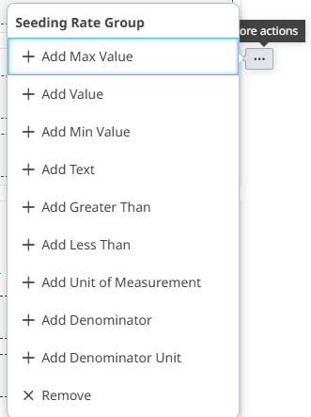

Key Features – Quill Authoring – GAP/DFU
Seeding Rate with Denominator and Denominator
Unit
  Actions menu gives the full list
GAP/DFU > Data > Application Method
  Previously you had to go to
  Crop Set > Application Method
Enable input of decimal values (everywhere)
BBCH descriptions (read only)

Slide 7
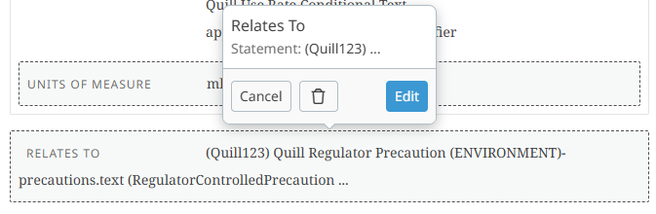
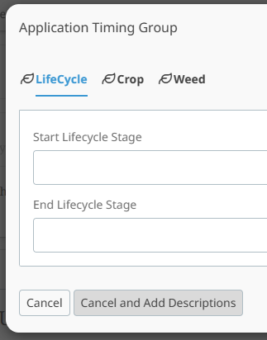
Key Features – Quill Authoring – GAP/DFU
Relates to popover with statement selector
  Previously you had to manually enter the common code, and some statements don’t have codes…
Application Timing Stages
and
Crop Stage Group
and
Pest Stage Group
  Cancel and Add Descriptions

Slide 8
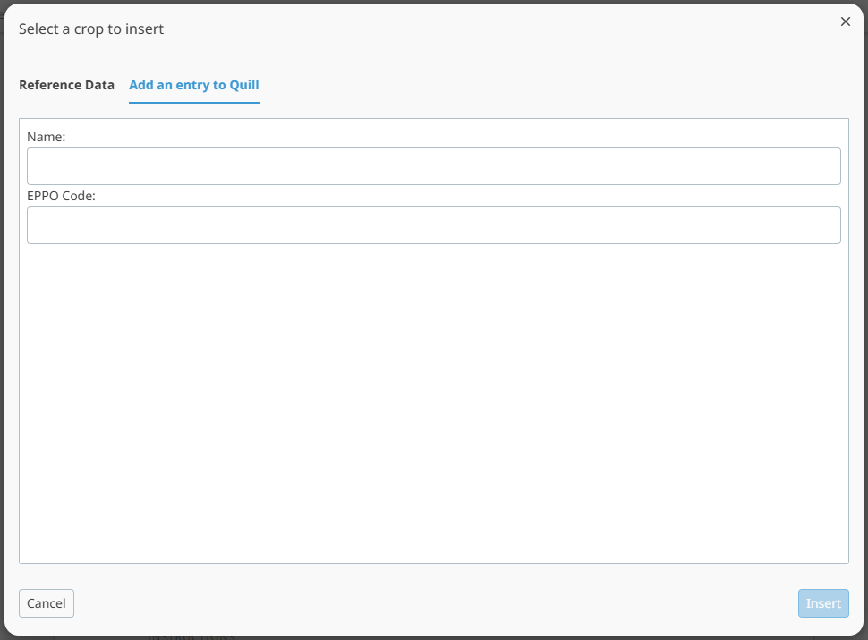
Key Features – Quill Authoring – GAP/DFU
Reference Data: If you can’t find the target crop or target pest you need for your label, you can add the name of the target and optionally the EPPO code:
  This will help us to automatically
  run reports to submit requests
  to the AgriGuide reference data
  team
Our digitisation team will also
add the target name and EPPO
if the EPPO can be found
We have a new report we can
automate to submit to AgriGuide

Slide 9
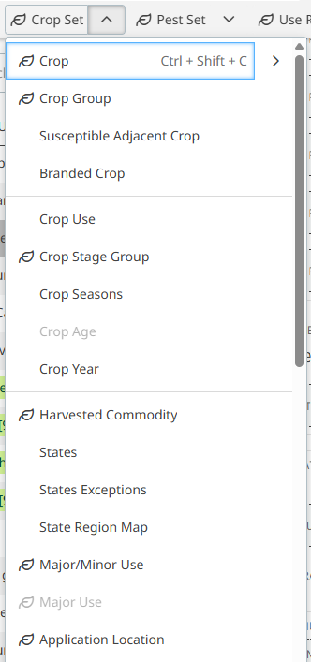

Key Features – Quill Authoring – GAP/DFU
Cultivation Setting can now be found in Crop Set > Application Location
  Your current labels don’t change, but we hid the button in ‘Data’ to more closely align with AgriGuide

Slide 10
Digitisation Automation
Leverage latest AI models for more precise and robust automation
Update automation mapping to work with new objects

Slide 11
Quill CMS
Import ‘unitLongName’ from AgriGuide reference data
Enable JSON objects containing a space (placeholder words)
Performance Improvements: Faster Quill

